Slide 1
OOP JavaScript
Autumn Frontend Internship 2021

Slide 2
Hi, I’m Paula

Slide 3
Agenda
OOP Concepts
Objects in JavaScript
Prototype and classes
TypeScript
Homework

Slide 4
Let’s play a game!
Kahoot.it

Slide 5
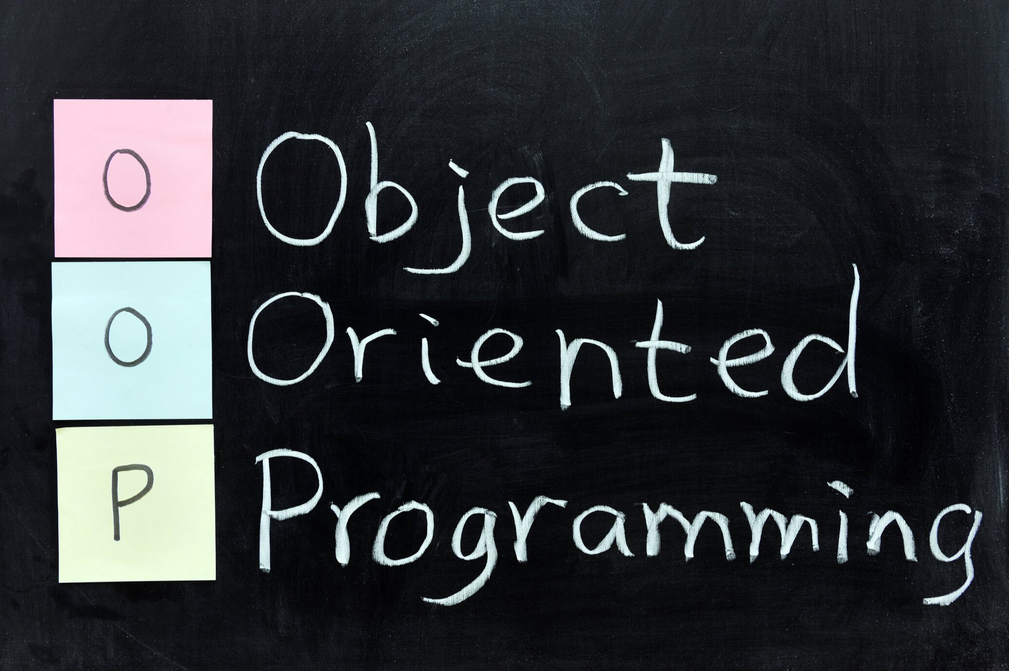

Slide 6
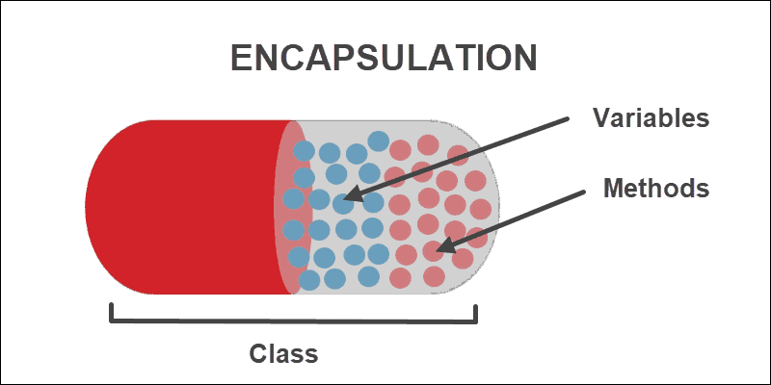
Encapsulation

Slide 7
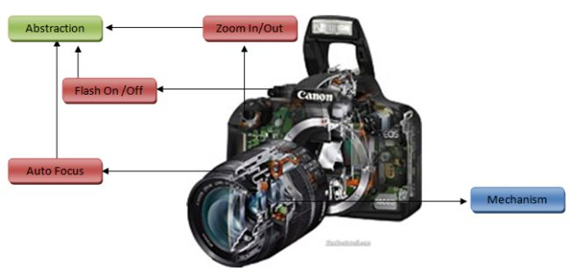
Abstraction

Slide 8
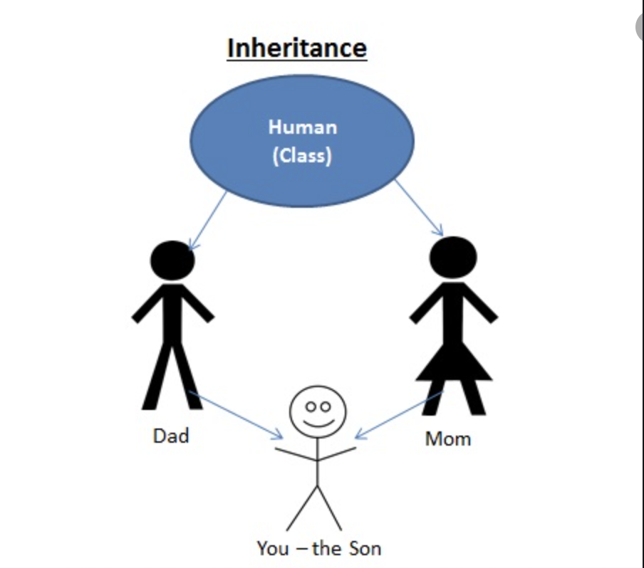
Inheritance

Slide 9
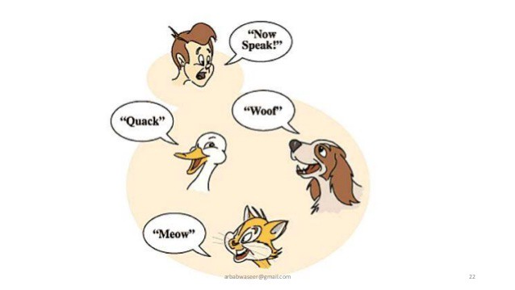
Polymorphism

Slide 10
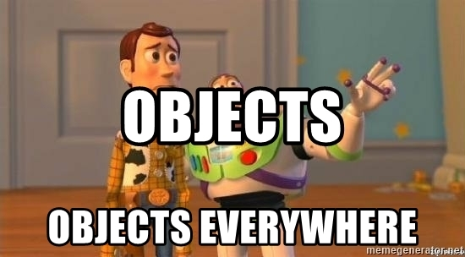
OOP in JavaScript

Slide 11
Objects in JavaScript
Objects are collections of properties and methods which represent data and functionality

Slide 12
Properties and methods
Name/value pair
Dynamic notation: property name as variable
Static notation:
Dot
Bracket

Slide 13
Constructors and instances
3 + 1

Slide 14
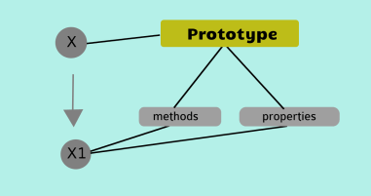
Prototype

Slide 15
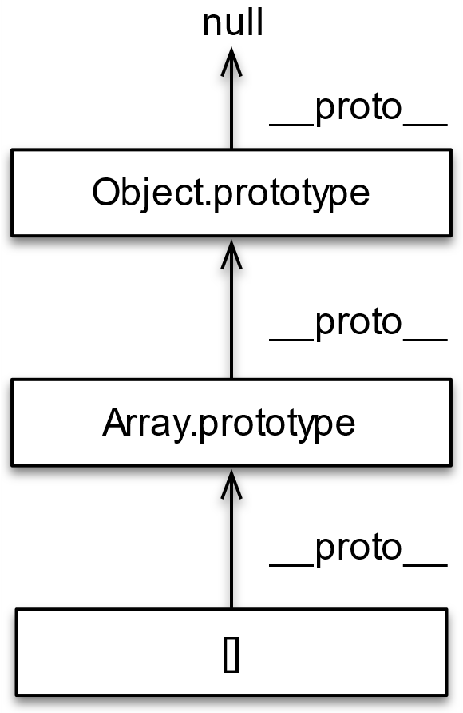
Prototype Chaining

Slide 16
Prototype chaining
Prototype vs __proto__
getPrototypeOf
Instance of
isPrototypeOf

Slide 17
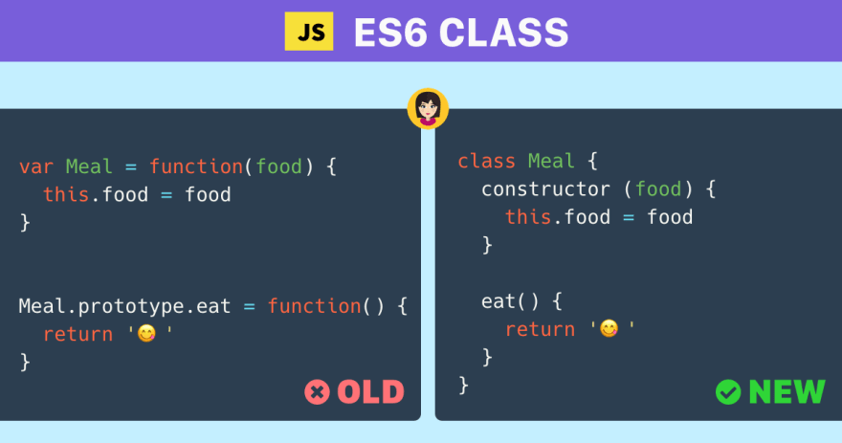
Class

Slide 18
Class
Extends
Super
This

Slide 19


Slide 20
Why?
Transpilation
Strong Static Typing
OOP
Proper documentation

Slide 21
Types
“any” type -> the way out, dynamic and super type of all types in JS
Enums
Classes
Interfaces
Tuples

